Slide 1
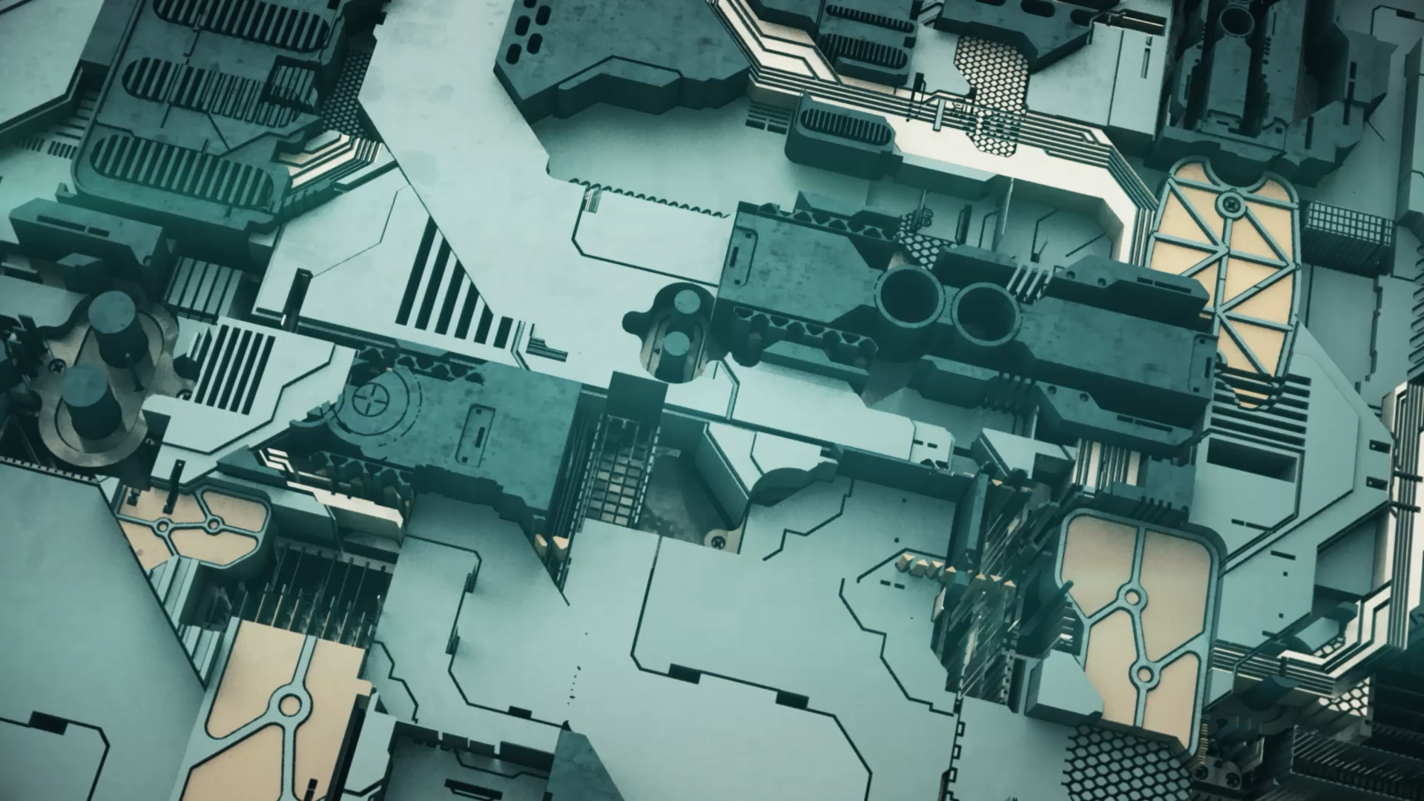
Autonomous Drone System Using Computer Vision
Team DeepThinkers
Bradley Johnson
Ethan Pham
Hoang Dinh
Violetta Basden

Slide 2
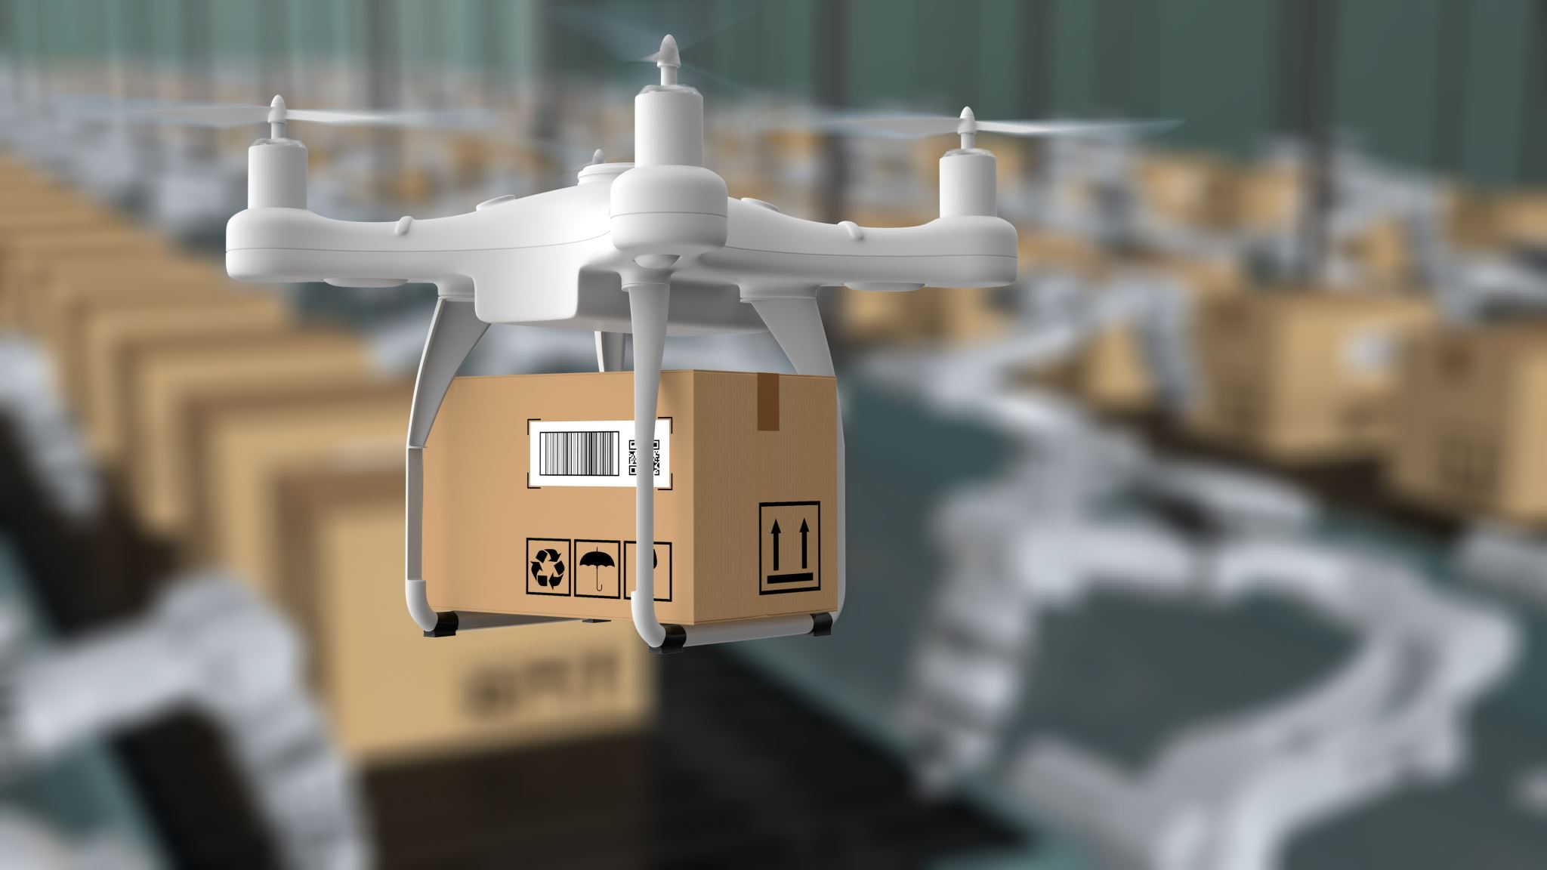
Project Focus
Develop a semi-to-fully autonomous drone
Uses computer vision for navigation + detection
Can:
Read license plates
Track objects
Monitor environments

Slide 3
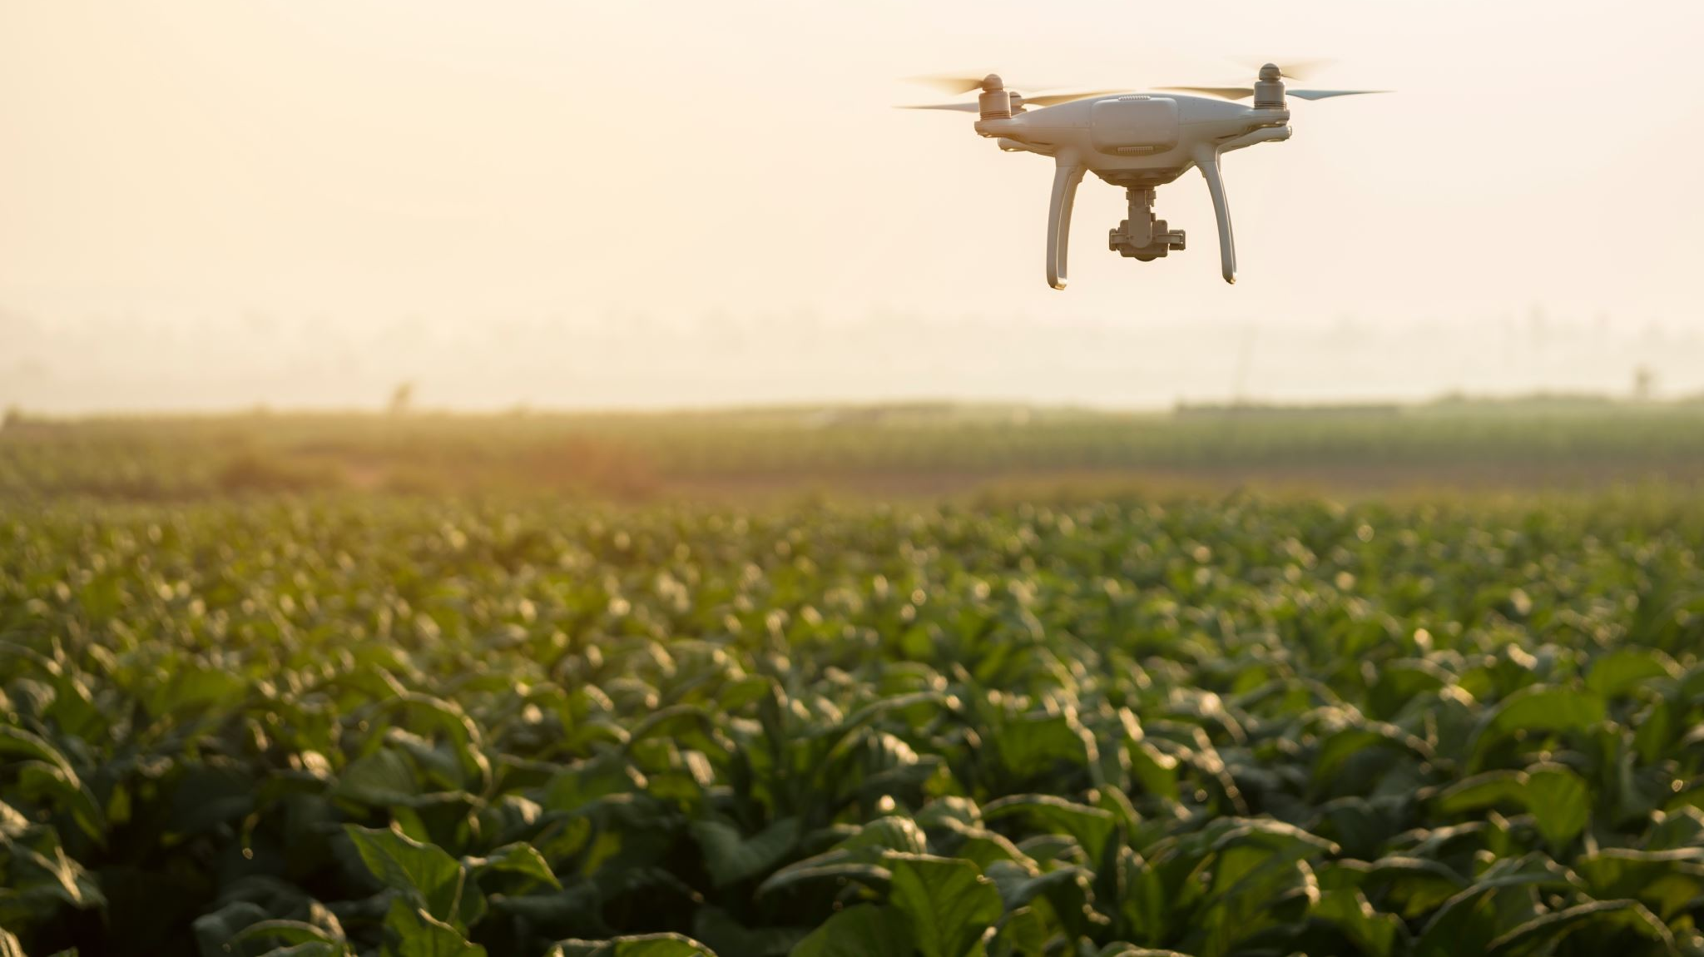
Problem
Manual drone operation:
Requires constant human control
Limited efficiency
Fixed cameras:
Limited coverage
Need for:
Mobile + intelligent monitoring system

Slide 4

Solution
An autonomous drone that:
Navigates using computer vision + sensors
Detects and reads license plates in real time
Can adapt to environment without constant input

Slide 5

Core System Architecture
3 Main Layers:
Flight Control System
Stabilization + movement
Computer Vision System
Detection + decision making
Navigation System
Path planning + obstacle avoidance

Slide 6
How Autonomous Flight Works
Camera captures live video
Vision model processes frames
Detects:
Objects
Ground movement
Obstacles
Drone adjusts movement automatically
Targets (license plates) are identified and tracked

Slide 7

Computer Vision Capabilities
License plate detection (YOLO / OpenCV)
Optical Character Recognition (OCR)
Object tracking
Visual positioning (optical flow)

Slide 8
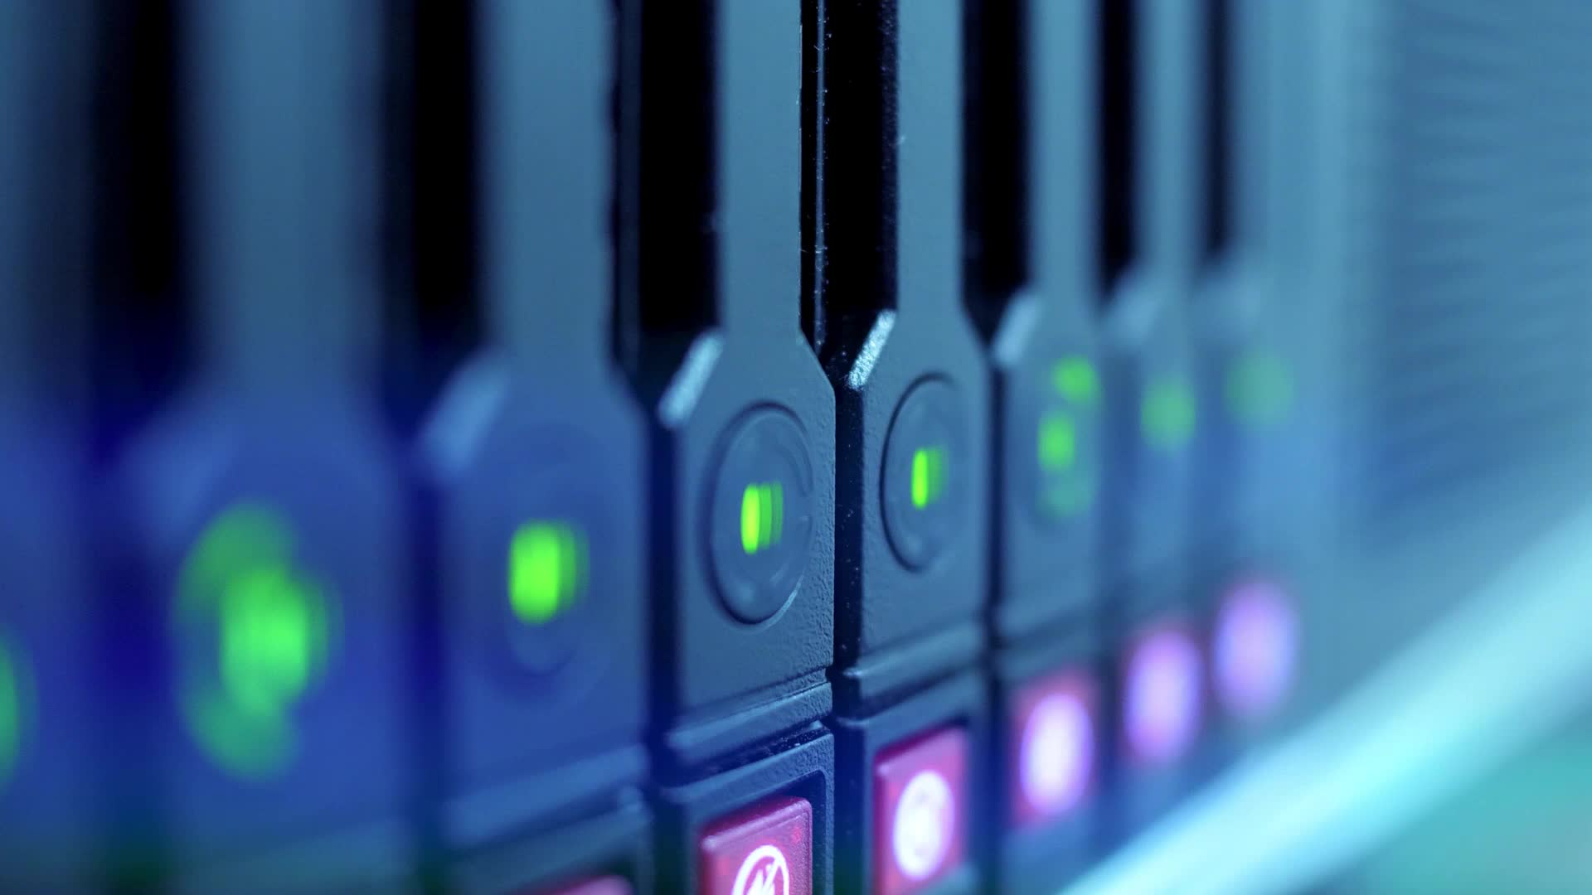
Autonomous Navigation Stack
Flight Controller (FC) → Stabilization
Companion Computer (Pi 5) → Vision + AI
Sensors:
Optical flow → position hold
Radar/ultrasonic → obstacle avoidance

Slide 9

Software Stack
OpenCV → image processing
YOLO → object detection
Tesseract OCR → plate reading
Python scripts → control logic
Drone firmware (Betaflight / PX4)

Slide 10
Example Use Cases
Parking lot monitoring
Campus security
Traffic observation
Search & tracking tasks

Slide 11

Key Challenges
Real-time processing limits on Raspberry Pi
Stable flight while processing vision
Lighting conditions affecting detection
Sensor accuracy and calibration

Slide 12

Future Improvements
Full GPS waypoint navigation
Edge AI acceleration (Jetson Nano / Coral TPU)
Swarm drones
Cloud-based plate database

Slide 13
Responsibilities
Bradley Johnson- hardware assembly and drone frame integration.
Ethan Pham- Responsible for computer vision implementation and testing.
Hoang Dinh-software integration and backend development for the computer vision processing system.
Violetta Basden-system coordination and project management.

Slide 14
Time Line
Phase | Task | Deliverable | Responsible Member(s) | Target Completion
Phase 1 | Project planning and system design | Project concept and system architecture | All Members | March 10, 2026
Phase 2 | Bill of Materials development | Complete component list and sourcing plan | Hoang Dinh | March 15, 2026
Phase 3 | Hardware acquisition and preparation | Drone frame and core components | Bradley Johnson, Violetta Basden | March 25, 2026
Phase 4 | Drone assembly and hardware integration | Assembled drone prototype | Bradley Johnson, Violetta Basden | April 5, 2026
Phase 5 | Computer vision development | License plate detection pipeline | Ethan Pham | April 10, 2026
Phase 6 | System integration | Drone and computer vision system connected | Hoang Dinh, Ethan Pham | April 15, 2026
Phase 7 | Testing and debugging | Functional prototype demonstration | All Members | April 20, 2026
Phase 8 | Documentation and report preparation | Final technical report draft | All Members | April 25, 2026
Phase 9 | Final review and submission | Completed report and project deliverables | All Members | May 1, 2026

Slide 15

Major Project Deliverables
A fully assembled drone prototype platform
Integration of a Raspberry Pi 5 computing unit
Implementation of a computer vision pipeline for license plate detection
Testing and validation of the prototype system
A complete technical report describing the system design and development
A final project presentation and demonstration

Slide 16
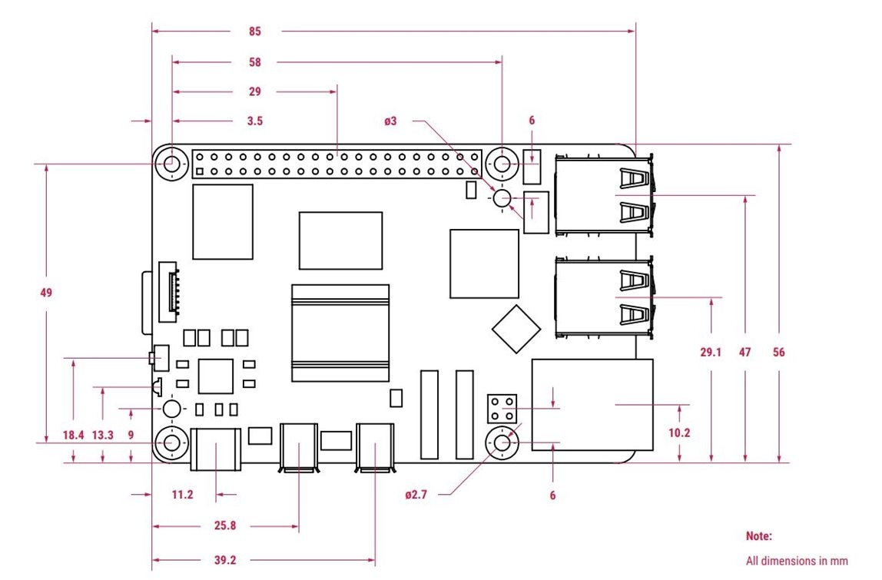
Bill of materials
Component | Qty
Raspberry Pi 5 (8GB) | 1
Camera Module v3 | 1
Secondary Camera (optional) | 1
MicroSD 64GB | 1

Slide 17
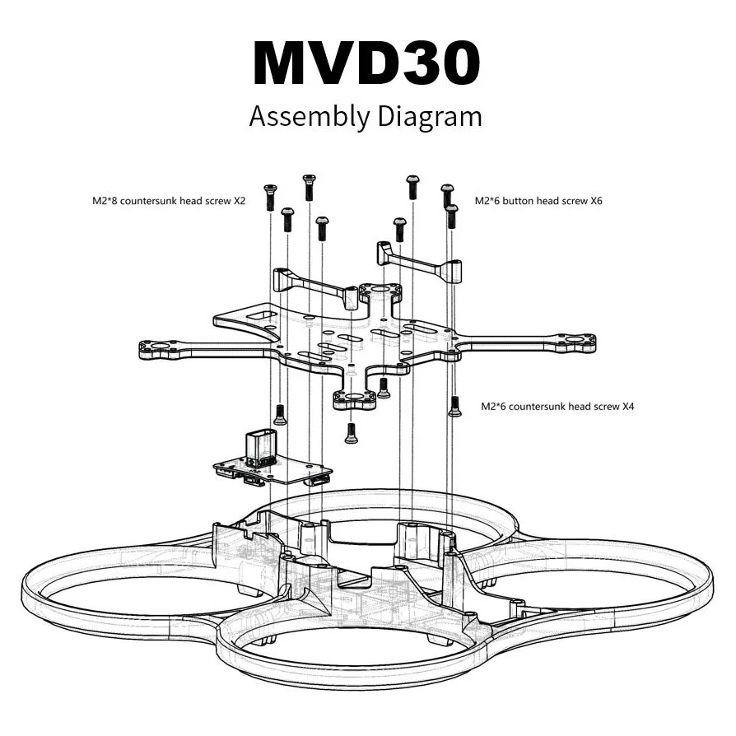
Flight & Control
Component | Qty
Flight Controller (MicoAir743v2-AIO-45A) | 1
Brushless Motors (AOS RC Supernova 1605) | 4
Ruby fpv VTX (Wyvern Link OpenIPC) | 1
Propellers (Gemfan D76 ) | 8
Drone Frame (MVD30 O4 Frame) | 1

Slide 18
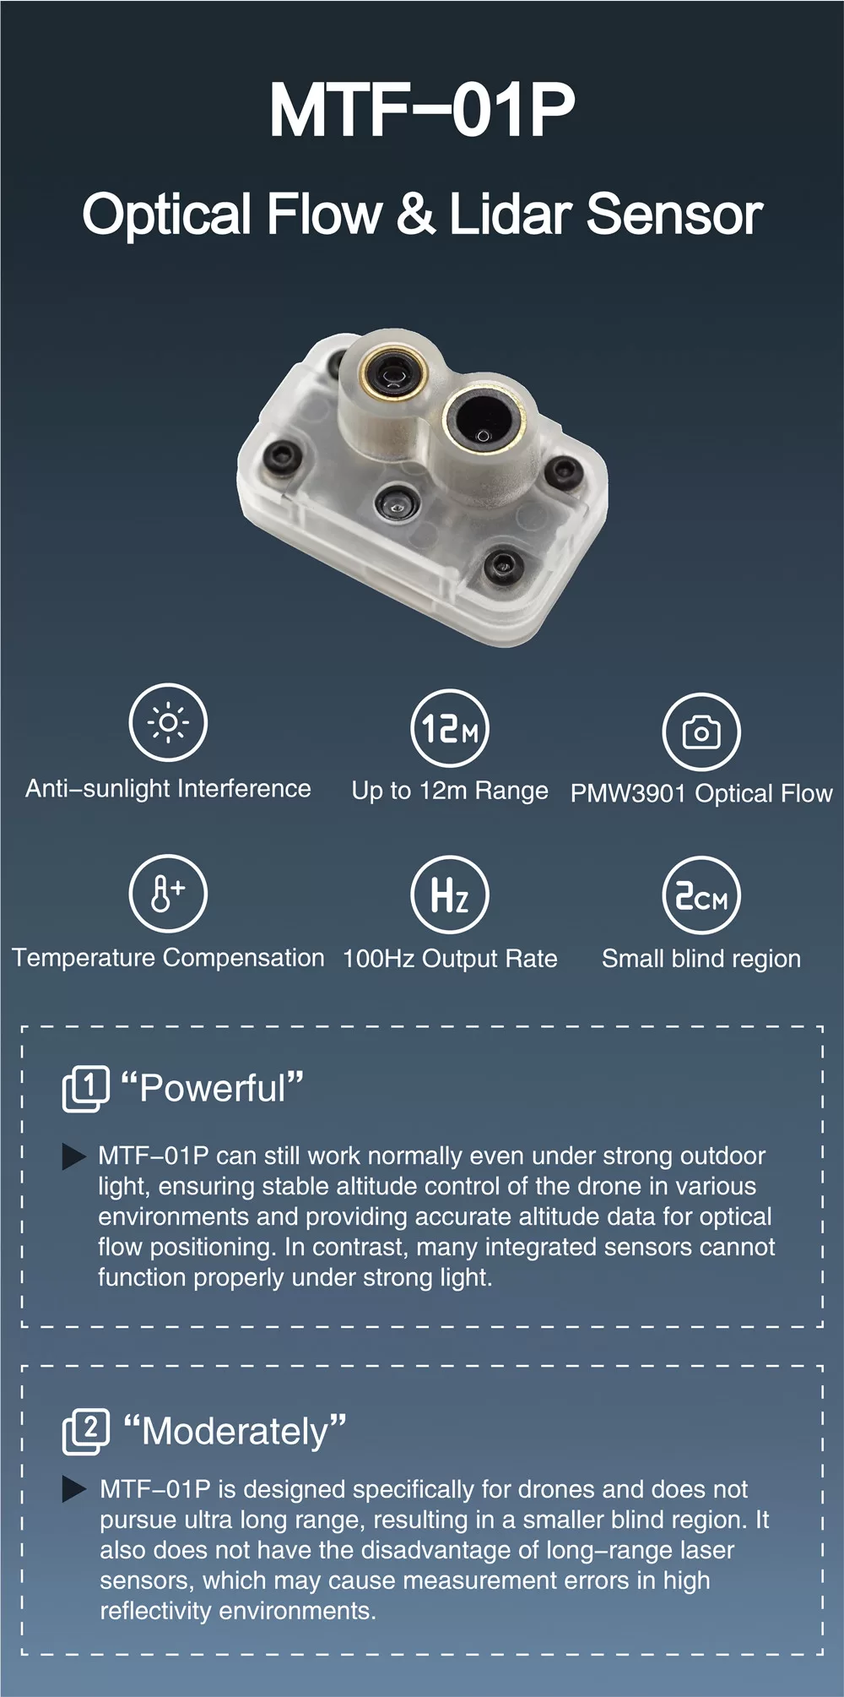
Navigation & Autonomy Sensors
Component | Qty
Optical Flow Sensor (MTF-01P) | 1
Ultrasonic Sensor (HC-SR04 ) | 2
mmWave Radar / LiDAR (Garmin LIDAR-Lite v3) | 1 (Optional)

Slide 19
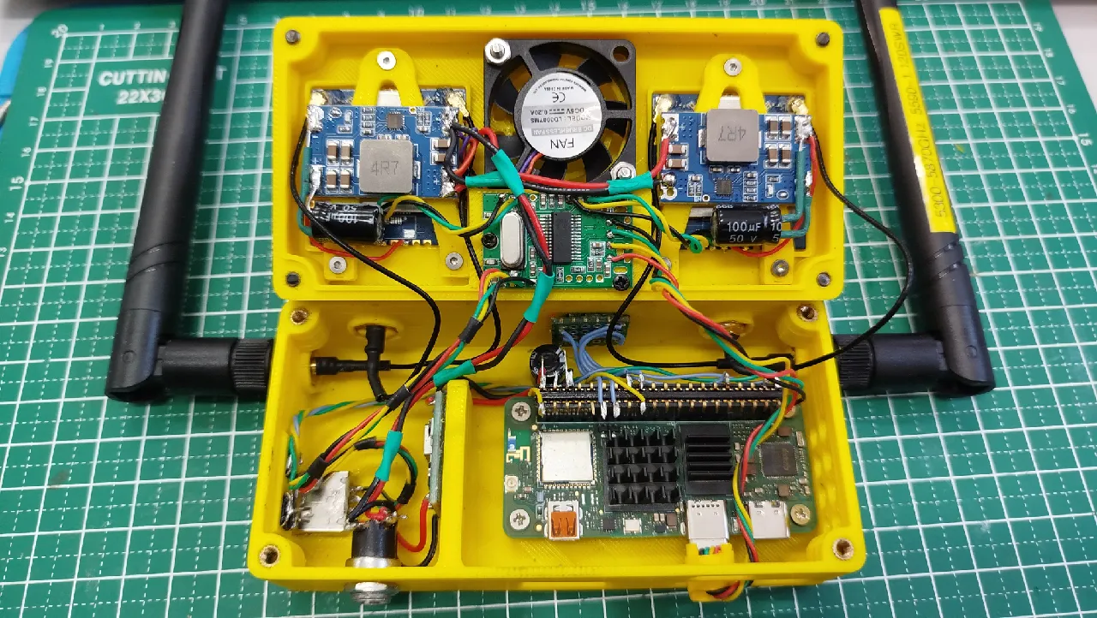
Accessories
Component | Qty
LiPo Battery 4s (tattu R-Line Version 5.0 850mAh) | 1–2
Radio (Radiomaster Boxer) | 1
FPV Goggles (HDZero Box pro+) RubyFPV VRX | 1

Slide 20
Fasteners
Frame Assembly
M3 x 8mm → 16 pcs
M3 x 10mm → 8 pcs
M3 nuts → 24 pcs
M3 washers → 24 pcs
Motors
M2 x 6mm → 16 pcs
Flight Controller Stack
M3 x 20mm standoffs → 4 pcs
M3 x 6mm screws → 4 pcs
Rubber dampers → 4 pcs
Raspberry Pi Mount
M2.5 x 6mm → 4 pcs
M2.5 standoffs → 4 pcs
Camera Mount
M2 x 5mm → 4 pcs
Extras
Zip ties → 25 pcs
Velcro straps → 3 pcs

Slide 21
Conclusion
Moves beyond manual drones → intelligent autonomous system
Combines:
AI
Robotics
Embedded systems
Real potential for smart monitoring applications

Slide 22
